Slide 1
Diagonals of a rhombus
Constructions

Slide 2
how to use Oak lessons

Slide 3
I can appreciate that the diagonals of a rhombus bisect one another at right angles and the angles are bisected.

Slide 4
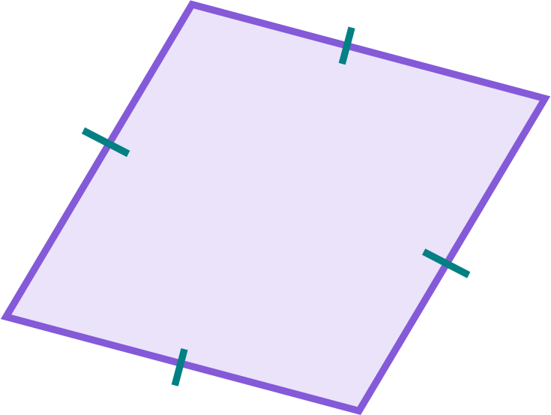
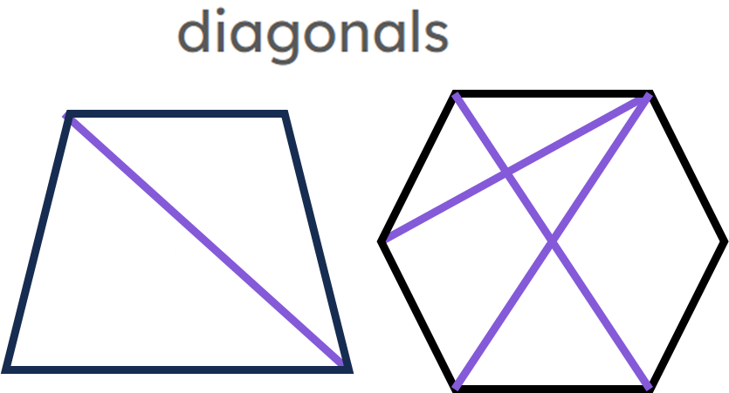
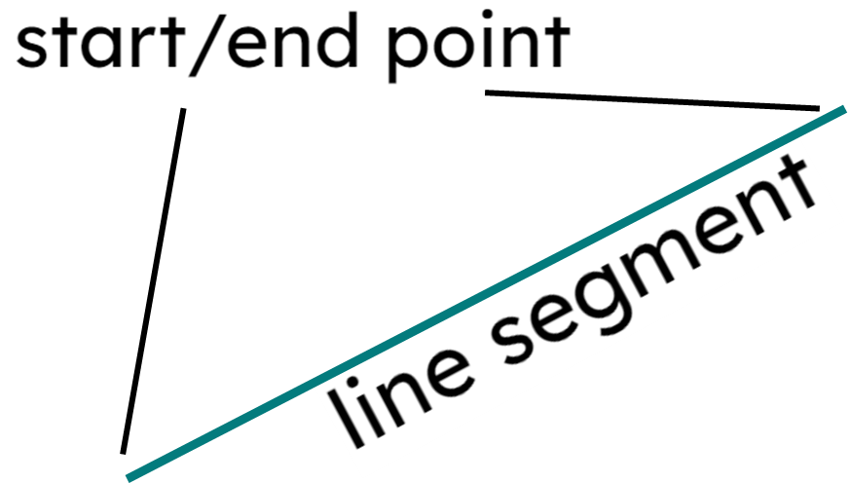
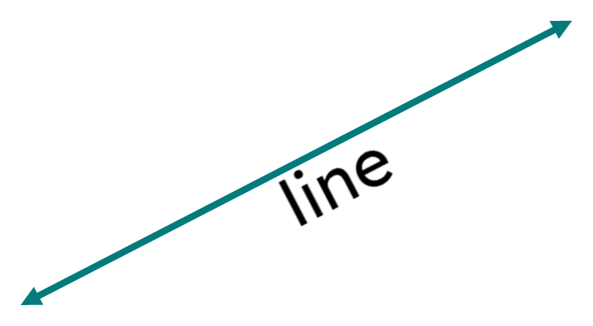
A rhombus is a parallelogram where all sides are the same length.
The diagonal of a shape is a line segment between two non-adjacent vertices.
If one shape can fit exactly on top of another using rotation, reflection or translation, then the shapes are congruent.
A line segment is a part of a line with a fixed start point and a distinct fixed end point.
A line is a straight 1D figure that does not have a thickness, and it extends forever in both directions.

Slide 5
To bisect means to cut or divide an object into two equal parts.
The altitude of a triangle is a line segment from a vertex of a triangle to the opposite edge. It is perpendicular to that edge.

Slide 6

Diagonals of a rhombus
Isosceles triangles
Properties of a rhombus

Slide 7
Isosceles triangles
Isosceles triangles have some important features:
2 equal angles
2 equal edges
1 line of symmetry

Slide 8



Isosceles triangles
In this isosceles triangle ABC, ∠ABC = 76°
This means that ∠BCA = 76° too.
A
28°
76°
C
76°
Sam
Then we can calculate that ∠BAC = 28°
B
Aisha

Slide 9
Isosceles triangles
In this isosceles triangle ABC, ∠ABC = 76°
The symmetry of the triangle means that half of ∠BAC is either side of the line. The angle is bisected.
A
28°
76°
C
76°
Sam
M
The line of symmetry splits it into two identical triangles.
B
Aisha

Slide 10
Isosceles triangles
In this isosceles triangle ABC, ∠ABC = 76°
Using only triangle ABM, ∠BMA = 180 - (14 + 76) = 90°
A
28°
76°
C
14°
A
76°
Sam
M
So the line of symmetry of an isosceles triangle is perpendicular to the base edge.
B
76°
M
B
Aisha

Slide 11
Isosceles triangles
If the non-base angle of an isosceles triangle is 34°, the line of symmetry will bisect the angle into two ° angles.
17

Slide 12
Isosceles triangles
The altitude of a triangle is a line segment from a vertex of a triangle to the opposite edge. It is perpendicular to that edge.
Examples of altitudes
Non-examples of altitudes
When the vertex overhangs the opposite edge, we extend the edge.

Slide 13
Isosceles triangles
Therefore, the line of symmetry in an isosceles triangle is also an altitude.

Slide 14


Isosceles triangles
Which of these altitudes is also the line of symmetry?
a
c
b

Slide 15
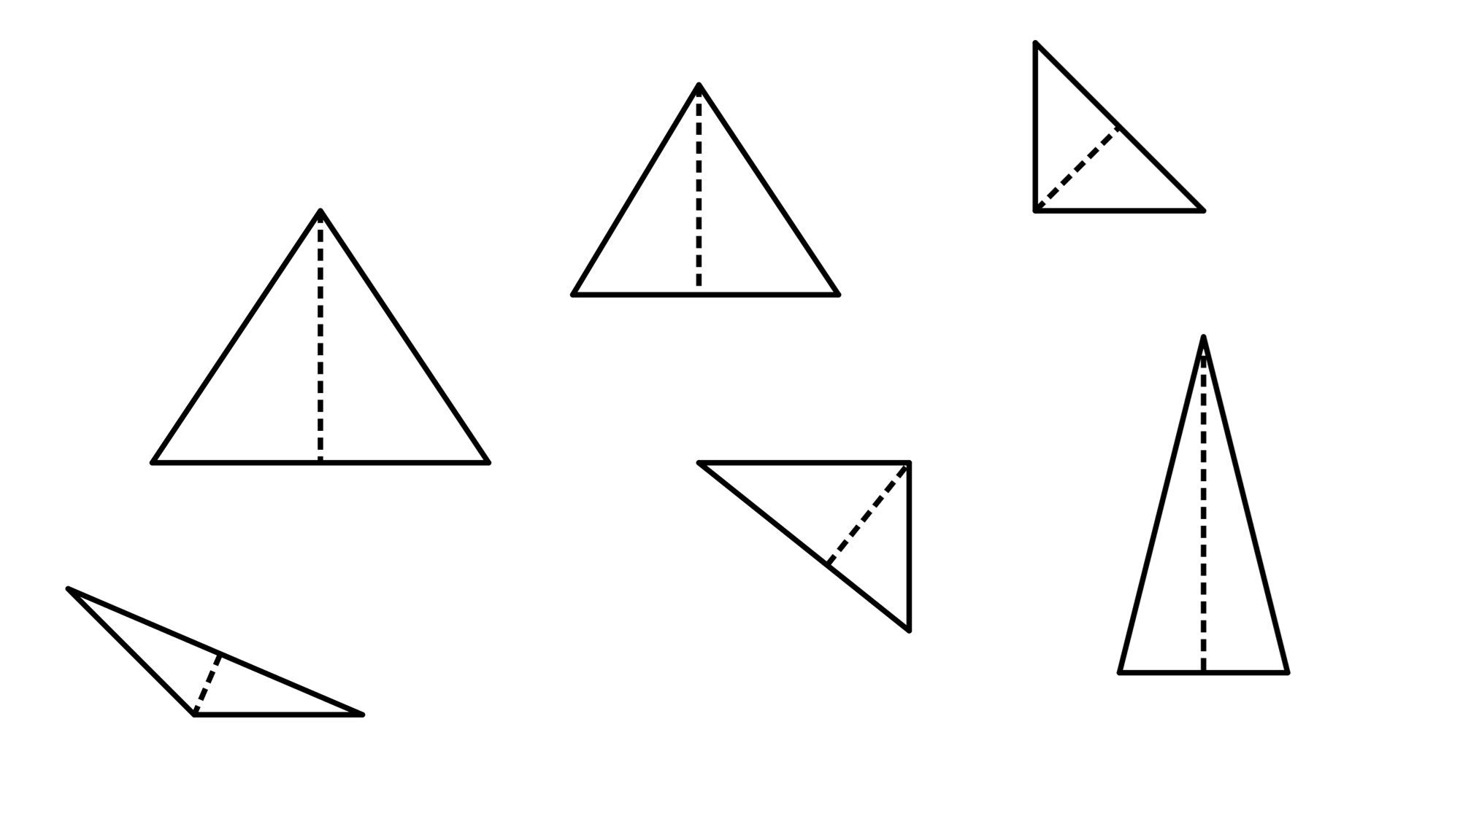
Isosceles triangles
1) Decide which of the following are isosceles triangles. If not, state why not.
a)
31°
b)
c)
74°
2.3 cm
53°
59°
2.3 cm
d)
e)
f)
73°
4 m
4 m
19 mm
73°
1.8 cm

Slide 16
Isosceles triangles
2) Add notation marks to the diagrams, where appropriate.
a)
b)
13 cm
27°
27°
13 cm
c)
45°

Slide 17
Isosceles triangles
1) Decide which of the following are isosceles triangles. If not, state why not.
74°
a)
31°
b)
isosceles
c)
isosceles
2.3 cm
isosceles
53°
2.3 cm
59°
d)
e)
f)
4 m
4 m
73°
19 mm
1.8 cm
not an isosceles - the altitude does not bisect the base edge
not an isosceles - there are not two equal edges
isosceles
73°

Slide 18
Isosceles triangles
2) Add notation marks to the diagrams, where appropriate.
a)
b)
13 cm
27°
27°
13 cm
c)
45°

Slide 19
Diagonals of a rhombus
Isosceles triangles
Properties of a rhombus

Slide 20
Properties of a rhombus
A rhombus can be thought of as two congruent isosceles triangles joined together at the base edge.

Slide 21
Properties of a rhombus
A rhombus can be thought of as two congruent isosceles triangles joined together at the base edge.

Slide 22
Properties of a rhombus
Each isosceles triangle is made from two congruent right-angled triangles, therefore the rhombus is made from four congruent right-angled triangles in total.

Slide 23
Properties of a rhombus
The dashed lines are the diagonals of the rhombus.
What can we infer about the diagonals of a rhombus?
they are perpendicular to each other
they bisect each other
they bisect the angle

Slide 24
Properties of a rhombus
The diagonals of a rhombus …
bisect each other
are perpendicular to each other
are always equal in length
bisect the angle

Slide 25
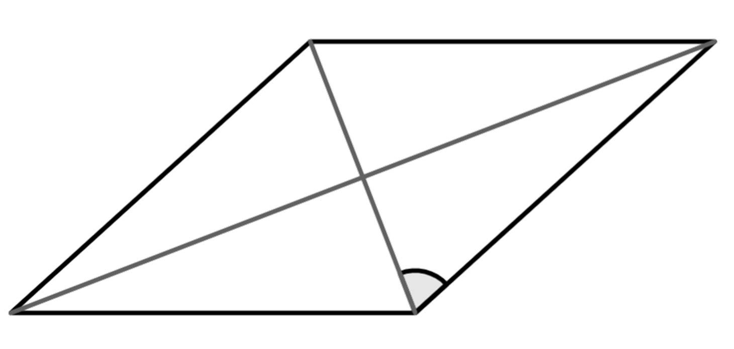

Properties of a rhombus
Here is a rhombus with the diagonals drawn on and one angle given.
Is this enough information to know all other angles on this diagram?
68°
Alex

Slide 26
Properties of a rhombus
Here is a rhombus with the diagonals drawn on and one angle given.
Diagonals in a rhombus are perpendicular to each other.
68°
Alex

Slide 27
Properties of a rhombus
Here is a rhombus with the diagonals drawn on and one angle given.
The diagonal bisects the angle it passes through.
68°
68°
Alex

Slide 28
Properties of a rhombus
Here is a rhombus with the diagonals drawn on and one angle given.
68°
68°
Two congruent isosceles triangles create a rhombus.
68°
68°
Alex

Slide 29
Properties of a rhombus
Here is a rhombus with the diagonals drawn on and one angle given.
68°
22°
68°
22°
Angles in a triangle sum to 180°
22°
68°
22°
68°
Alex

Slide 30
Properties of a rhombus
Here is a rhombus with the diagonals drawn on and one angle given.
44°
68°
22°
136°
68°
22°
The interior angles of this rhombus are 44°, 136°, 44° and 136°
22°
68°
22°
68°
Alex

Slide 31
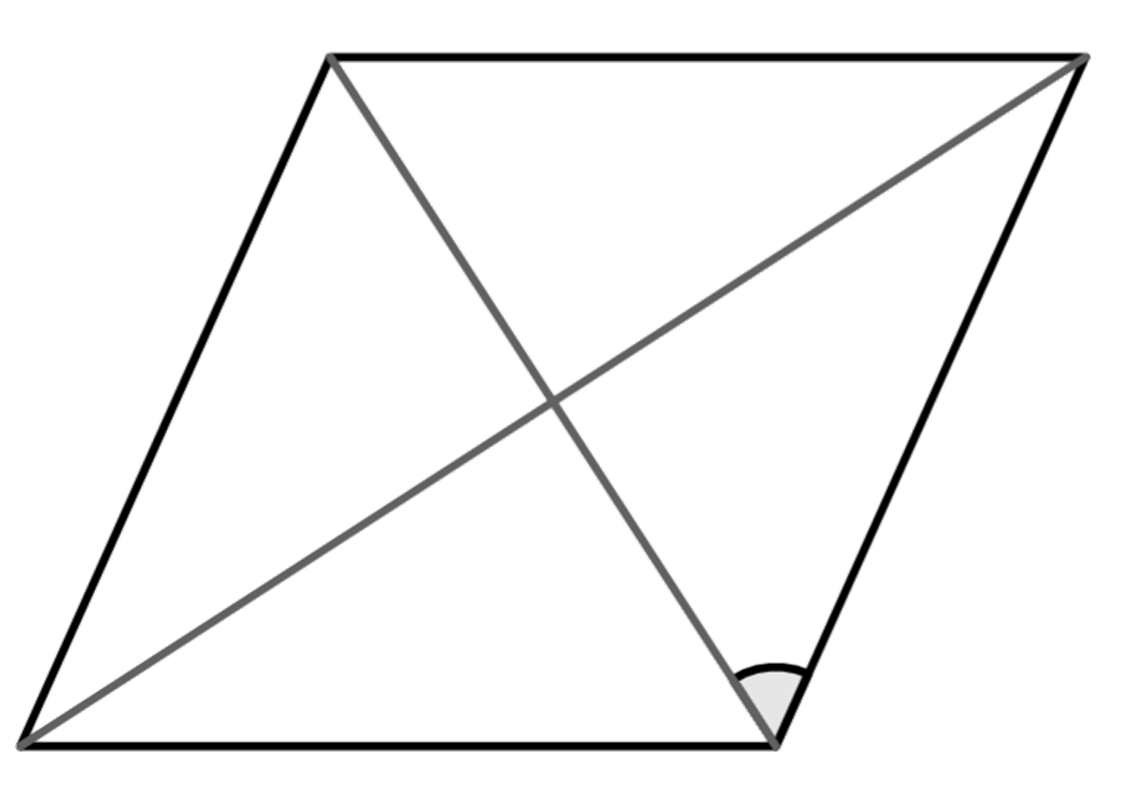
Properties of a rhombus
Here is a rhombus with the diagonals marked on and one angle given.
Work out the value of a, b and c.
b°
a = 90
b = 114
a°
c = 33
57°
c°

Slide 32


Properties of a rhombus
Izzy thinks she has drawn two sides and a diagonal of a rhombus.
Jun thinks that Izzy hasn’t managed to do that.
Who is correct?
Jun, the diagonal should bisect the angle but even without using a protractor it is clear the two angles are not equal.

Slide 33
Properties of a rhombus
Izzy tries again but this time draws two edges and both diagonals of the rhombus.
How can she check that this is accurate?
Use a protractor to check:
the diagonals are perpendicular to each other
the angle has been bisected
Use a ruler to check:
the diagonals have bisected each other
the rhombus’ edges are equal

Slide 34

Properties of a rhombus
Which of these show two edges and a diagonal of a rhombus?
a
b
c
d

Slide 35
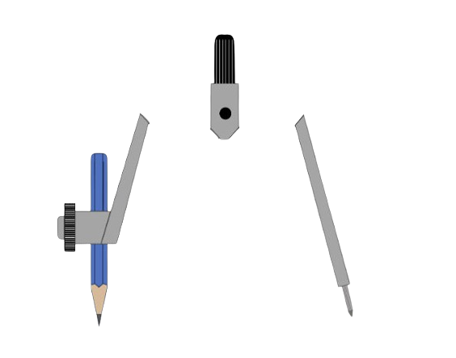

Properties of a rhombus
If we have two perpendicular lines, can a rhombus be constructed?
This would be the point at which the diagonals intersect.
The lines can be extended in all directions, but need to be equal either side, as the diagonals bisect each other.

Slide 36
Properties of a rhombus
If we have two perpendicular lines, can a rhombus be constructed?
This would be the point at which the diagonals intersect.
The lines can be extended in all directions, but need to be equal either side, as the diagonals bisect each other.

Slide 37
Properties of a rhombus
If we have two perpendicular lines, can a rhombus be constructed?
This would be the point at which the diagonals intersect.
The lines can be extended in all directions, but need to be equal either side, as the diagonals bisect each other.

Slide 38
Properties of a rhombus
The diagonals of this shape are perpendicular to each other. This must be a rhombus.
Aisha
Do you agree with Aisha?
No - in a rhombus the diagonals are perpendicular but they also need to bisect each other.

Slide 39
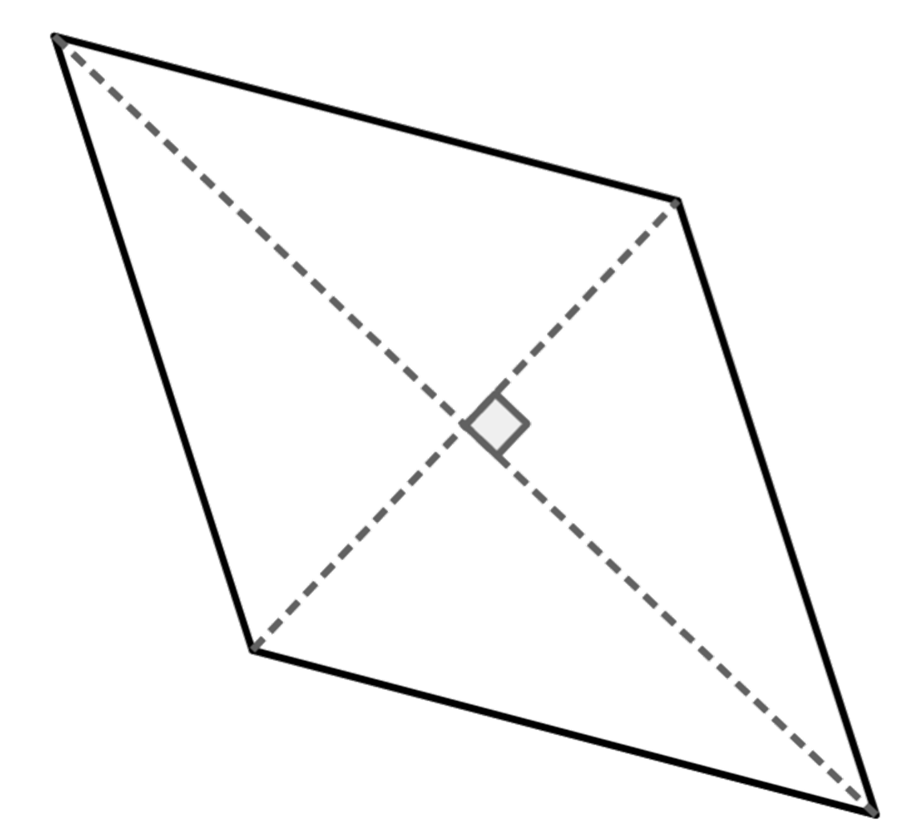
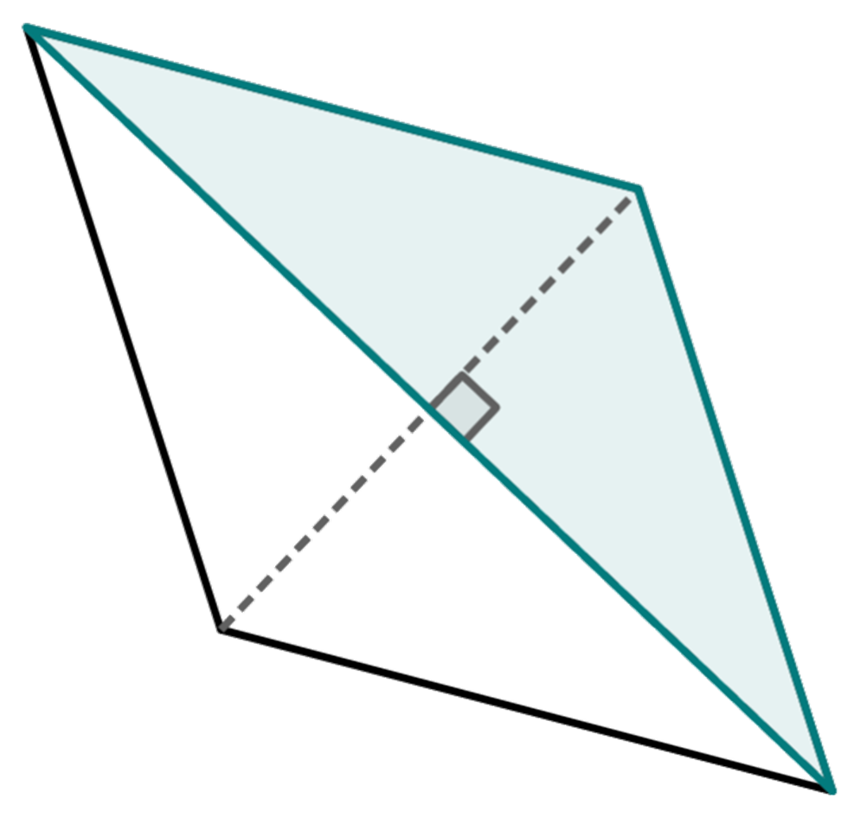
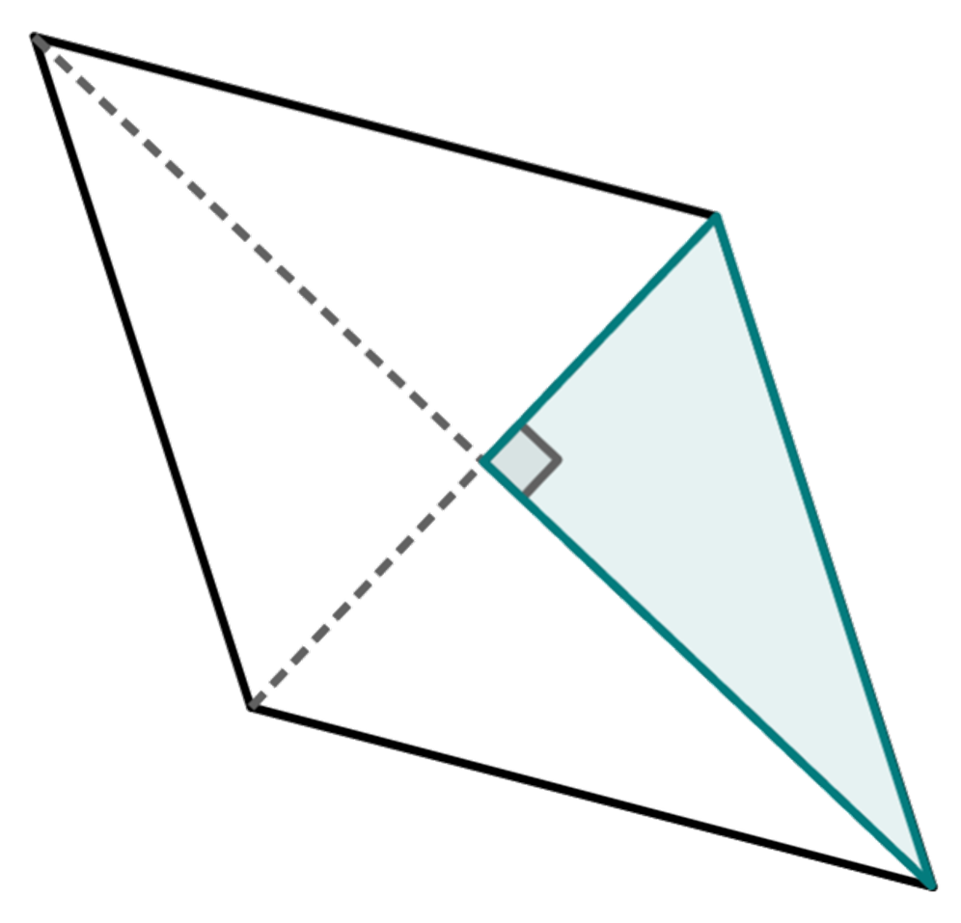
Properties of a rhombus
The diagonals of this rhombus have lengths of 10.5 units and 5.8 units.
What is the area of the rhombus?
The rhombus is made from two congruent isosceles triangles or four congruent right-angled triangles, so we can calculate the area using these.

Slide 40

Properties of a rhombus
The diagonals of this rhombus have lengths of 10.5 units and 5.8 units.
What is the area of the rhombus?
This isosceles triangle has a base length of 10.5 units and a perpendicular height of 2.9 units. Its area is × 10.5 × 2.9 = 15.225 unit²
So, the area of the rhombus is 30.45 unit²

Slide 41
Properties of a rhombus
The diagonals of this rhombus have lengths of 10.5 units and 5.8 units.
What is the area of the rhombus?
This right-angled triangle has a base length of 5.25 units and a perpendicular height of 2.9 units. Its area is × 5.25 × 2.9 = 7.6125 unit²
So, the area of the rhombus is 30.45 unit²

Slide 42
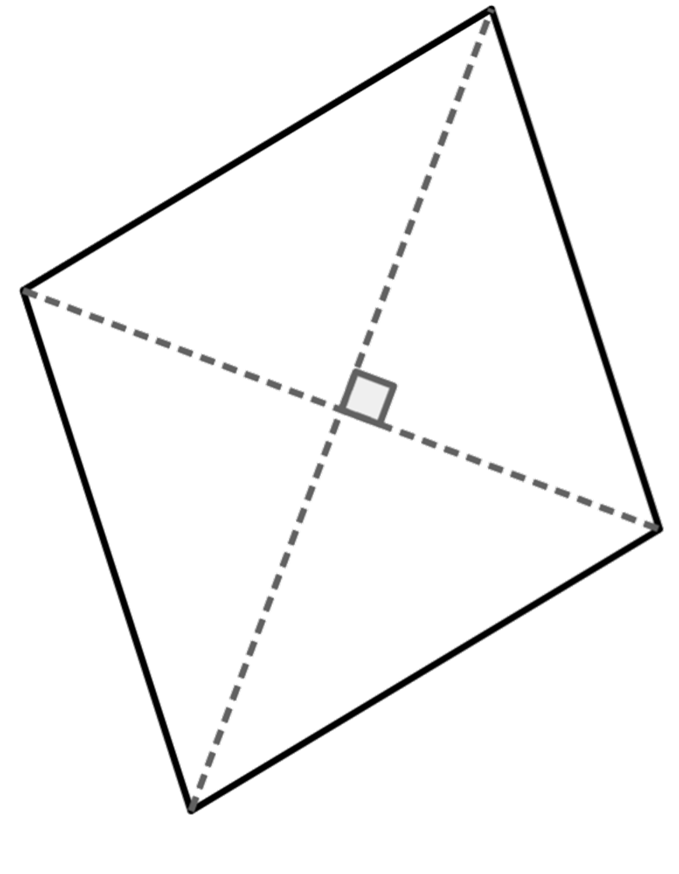
Properties of a rhombus
The diagonals of this rhombus have a length of 7.5 cm and 9.4 cm. What is the area of the rhombus?
Area =
2 × × 7.5 × 4.7 or 2 × × 3.75 × 9.4
or 4 × × 3.75 × 4.7
= 35.25 cm²

Slide 43
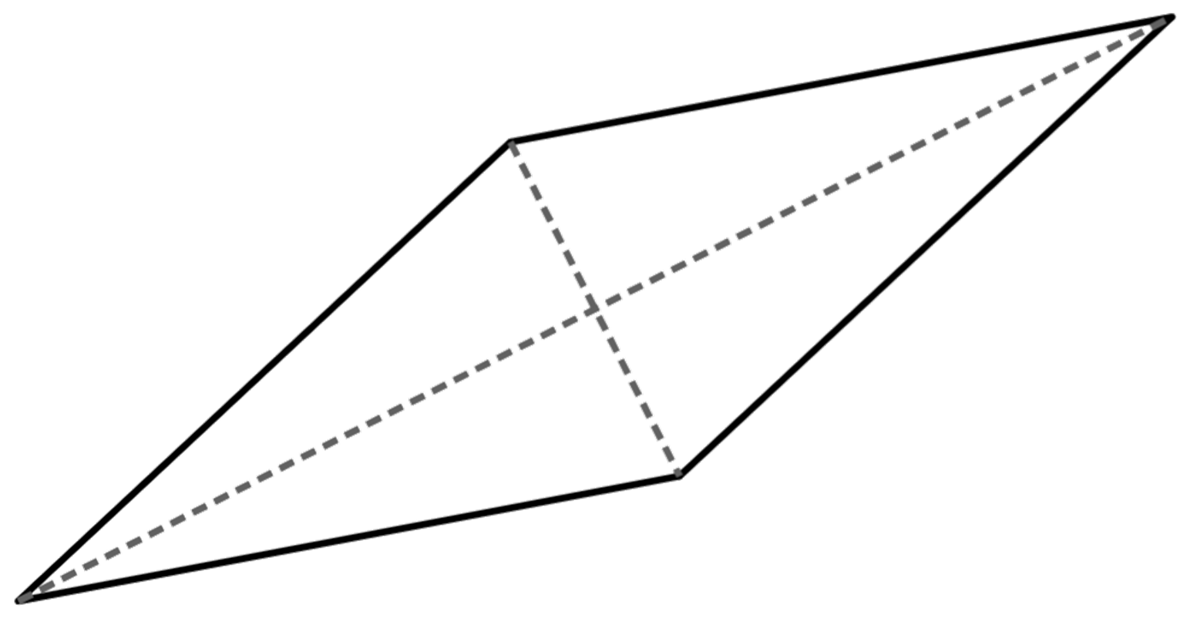
Properties of a rhombus
1) Work out the missing angles in these rhombi
a)
b°
b)
32°
a°
55°
e°
c°
d°

Slide 44
Properties of a rhombus
2) Work out the area of the rhombus in each part:
a) One diagonal is 8 cm and the other is 6 cm
b) One diagonal is 9 cm and the other is 4.5 cm
c) Half of one of the diagonals is 5 cm and the other diagonal is 1 cm

Slide 45
Properties of a rhombus
3) Construct a rhombus from this set of perpendicular lines.

Slide 46
Properties of a rhombus
1) Work out the missing angles in these rhombi
a)
b)
110°
32°
90°
55°
74°
35°
16°

Slide 47
Properties of a rhombus
2) Work out the area of the rhombus in each part:
a) One diagonal is 8 cm and the other is 6 cm
b) One diagonal is 9 cm and the other is 4.5 cm
c) Half of one of the diagonals is 5 cm and the other diagonal is 1 cm
24 cm² E.g. (0.5 × 4 × 3) × 4
20.25 cm² E.g. (0.5 × 4.5 × 4.5) × 2
5 cm² E.g. (0.5 × 5 × 1) × 2

Slide 48
Properties of a rhombus
3) Construct a rhombus from this set of perpendicular lines.
An example:

Slide 49
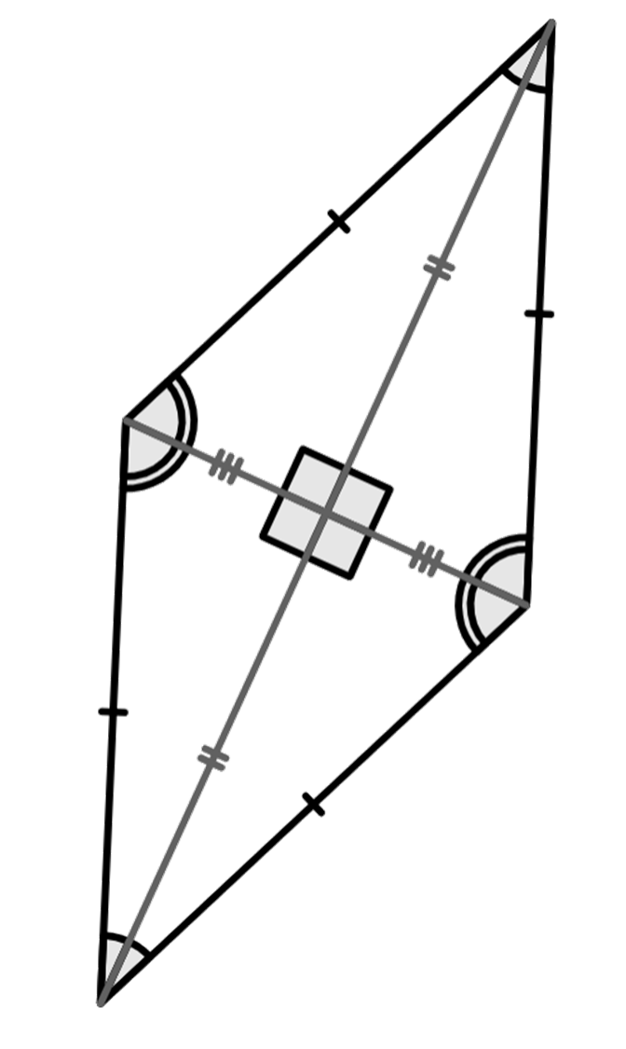
Diagonals of a rhombus
The diagonals of a rhombus:
are perpendicular to each other
bisect each other
bisect the angles that it passes through

Slide 50

© Oak National Academy 2023.
Produced in partnership with Mathematics in Education and Industry.
Licensed on the Open Government Licence v3.0, except where otherwise stated. See Oak terms and conditions.

